Slide 1
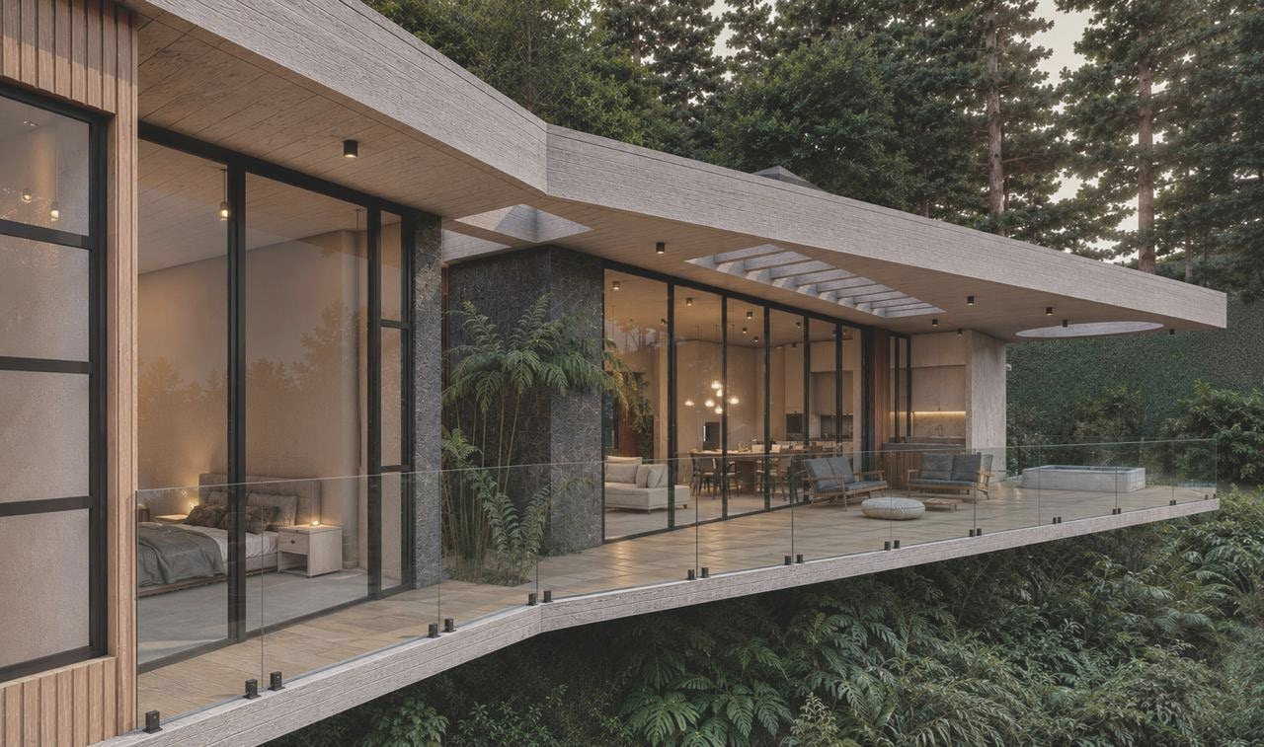




Dulcinea is the operating company. It sources, renovates and sells.
Dulcinea One: the first round. Qualified investors fund it; it buys, improves, rents and exits homes in Medellín.
Every home carries the Lola & Ber Hospitality co-brand.
Investor Deck
First round, offered to qualified investors.

Slide 2
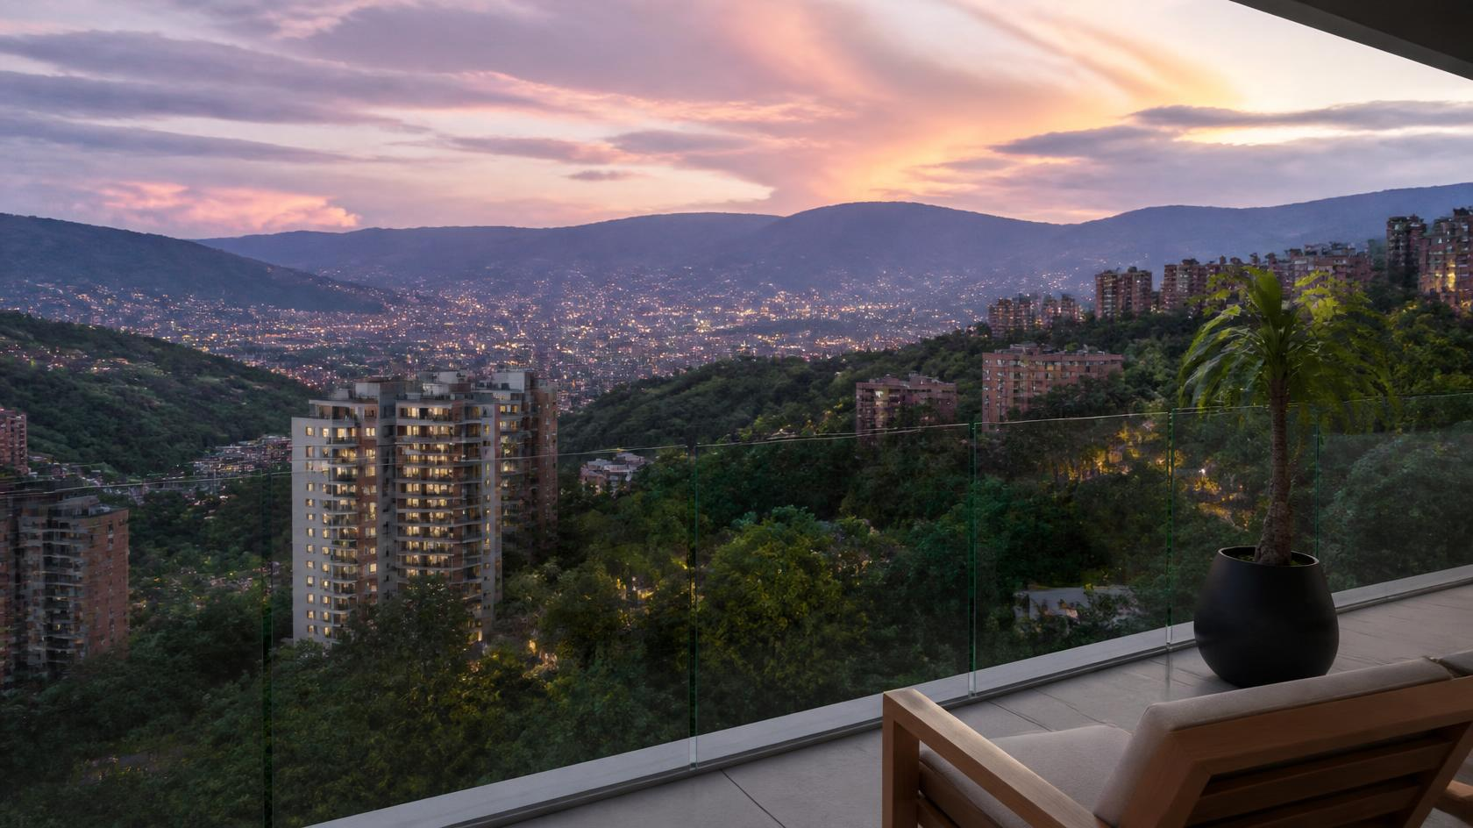
Why Medellín
Visitors come for a week, stay for a season, then buy.
01 · VISIT
1.2M
foreign visitors in 2024, up 26%; the US is #1
02 · STAY
62%
of arrivals are international, vs 36% in 2014
03 · OWN
10x
more tourist lodgings than 2014; 70% homes
ILLUSTRATIVE RENDER · EL POBLADO
22 °C all year, walkable streets, a 2-year remote-work visa.
EL POBLADO · APARTMENTS & PENTHOUSES
EL RETIRO · HOUSES ON PRIVATE LOTS
Relocating professionals, returning families
Space and privacy, short commute
Walkable, estrato 5–6
40 minutes from El Poblado
Sources: Sistema de Inteligencia Turística de Medellín (SIT), Alcaldía de Medellín 2024–25; Migración Colombia; Resolución 5477/2022.

Slide 3

The Gap in the Market
Buyers want six things from a finished home. Who delivers all six—
New-build developers
Resale agencies
Owner-sellers
Individual flippers
DULCINEA
1
2
3
3
6
of 6
of 6
of 6
of 6
of 6
tests cleared
tests cleared
tests cleared
tests cleared
tests cleared
Established location
Finished, not off-plan
One design standard
Rental management
Available now
Branded option
Established location
Finished, not off-plan
One design standard
Rental management
Available now
Branded option
Established location
Finished, not off-plan
One design standard
Rental management
Available now
Branded option
Established location
Finished, not off-plan
One design standard
Rental management
Available now
Branded option
Established location
Finished, not off-plan
One design standard
Rental management
Available now
Branded option
BOTTOM LINE
No seller clears more than 3 of 6. The gap is the whole product, not one feature.

Slide 4



Lola & Ber
Why put a hospitality brand on a house—
PROMISE
Freedom to be wholly yourself.
Grew out of retreats and events.
DEMAND
Sex-positive, open-minded adults.
They book the brand, not the price.
DESIGN BRIEF
Natural, warm, private.
Plants, stone, warm light. One standard for every remodel.
BOTTOM LINE
BY LOLA & BER · THE ENDORSED COLLECTION
Built-in demand, with no brand fee.
Each home keeps its own name. The brand sets the tone.
Dulcinea One owns the homes. ServCo operates them.

Slide 5
Economics
Gains come from both ends: bought below comps, sold at appreciation target.
Submarket
Entry price
Works
Bridge rental
Exit
El Poblado · El Retiro
20–30% below comps
6-9 months for improvements
Furnished let
25–35-month hold
BY PROPERTY · WHERE THE GAIN COMES FROM
IRR BRIDGE · DEAL TO INVESTOR
INVESTOR RETURNS · AFTER TAX & CARRY
13.2%
15.7%
18.5%
25% discount
30% discount
35% discount
BASE CASE
Base case 30%. Downside at 25%: 1.36x.
Cost · Bought below comps · Appreciation
$9.65M
1.44x
Year 4
distributed
MOIC
capital back
Five Investment Criteria properties: one bought, one in negotiation. Exits assume 8.5% El Poblado / 7.15% El Retiro yearly appreciation. USD at TRM 3,090.

Slide 6
Investment Criteria
KIT Capital’s Buy Box™: a ten-test acquisition filter, built deal by deal. A home clears all ten or we pass.
LOCATION
ENJOYMENT
PRODUCT
ENTRY PRICE
TRANSFORMATION
2 submarkets
Own & use
300–600 m²
20–30% below
~6 months
El Poblado and El Retiro only
homes investors want to live in
apartments, penthouses, houses
improved value at purchase
of works, incl. FF&E
DEEP DUE DILIGENCE
OPERATION
HOLD & EXIT
DEAL SIZE
MINIMUM RETURN
Full DD
$300–1,000
24–36 mo
$750K–$2M
15% IRR
technical, legal and title
per night · $9,500 cap per 28 nights
hold, then sell
all-in per home
to investors, after carry and gains tax
BOTTOM LINE Ten tests, no exceptions. Miss one and the home is not bought, whatever the price.

Slide 7
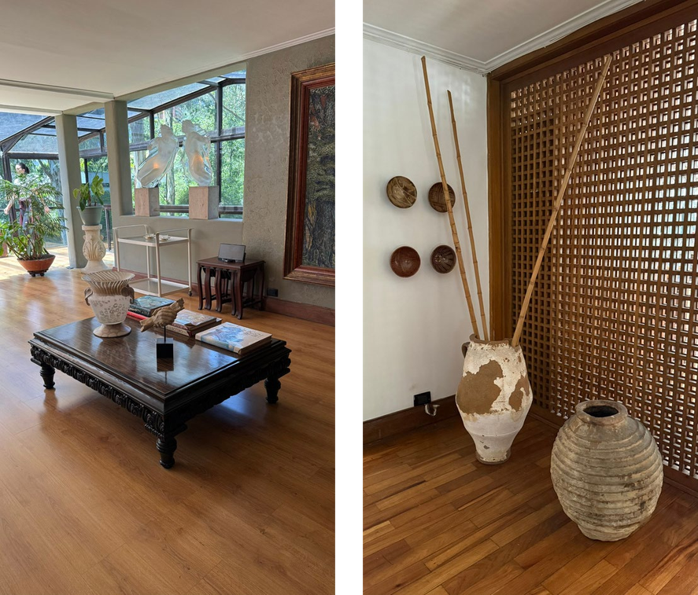
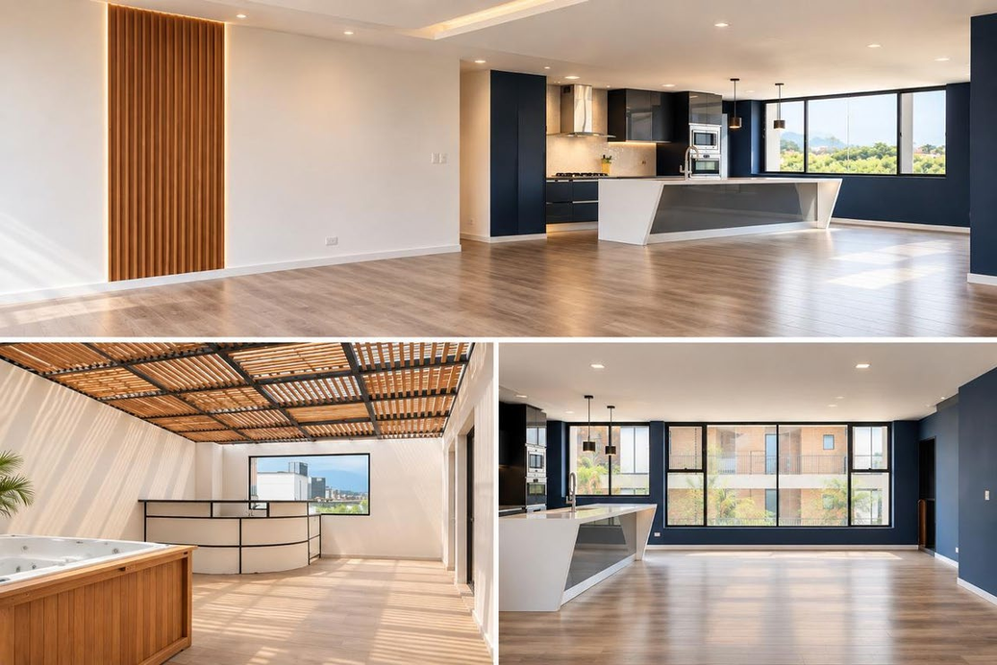
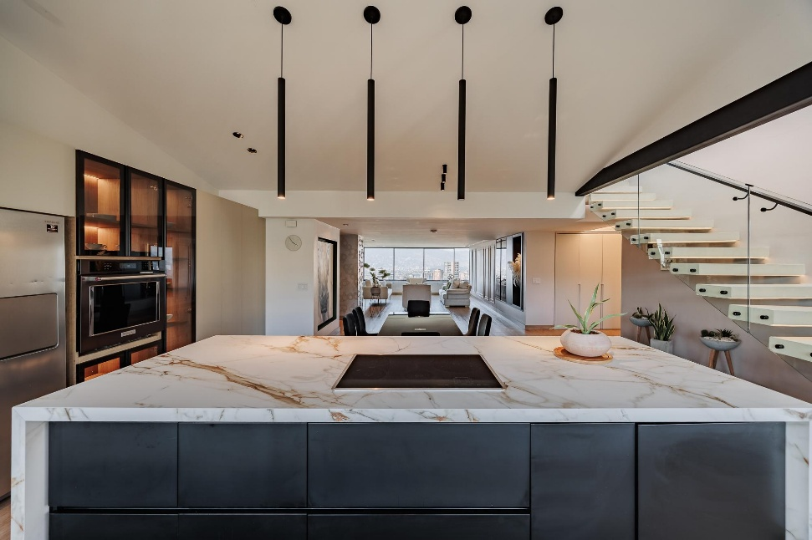
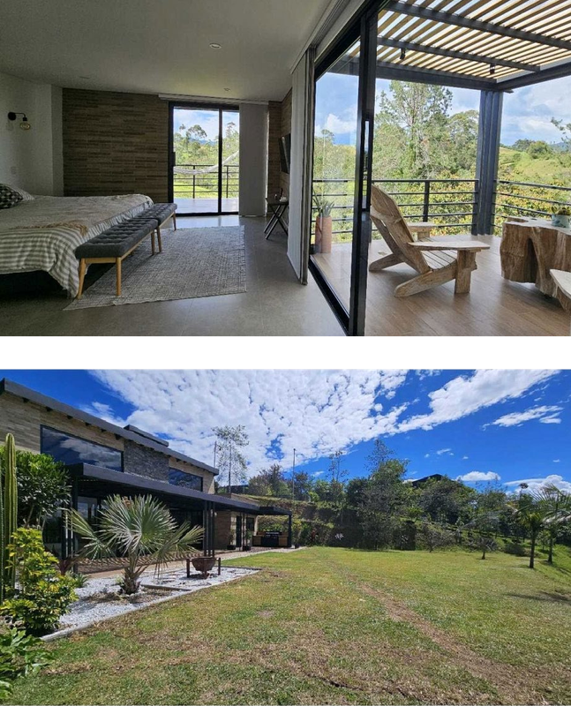
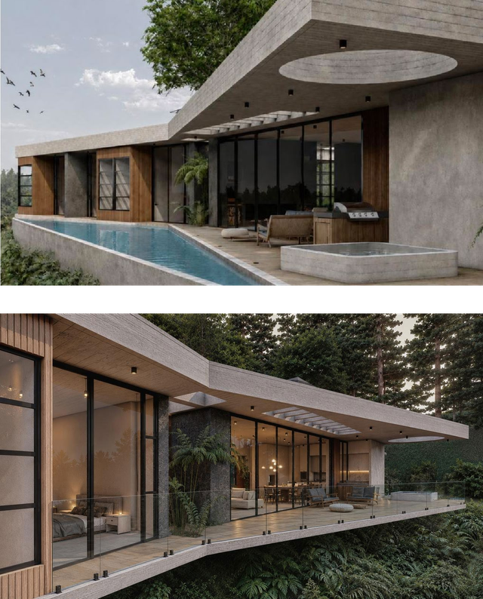
Investment Criteria in Action
Five properties that clear the criteria, each 20–30% below what a finished home sells for per m².
60+
HOMES WALKED
5
CLEAR THE CRITERIA
1 + 1
BOUGHT + IN NEGOTIATION
PROPERTY
TYPE · BUILT m²
PURCHASE $/m²
ALL-IN $/m²
RENOVATED COMP $/m²
CRITERIA
San Lucas 101
Poblado apartment · 325
1,369
2,300
3,285
✓
Aires de Campestre
Poblado penthouse · 489
1,363
2,390
3,414
✓
Fontanar 201
Poblado penthouse · 389
2,621
3,318
4,741
✓
Casa Monte Sereno
El Retiro house · 420
3,082
3,930
5,614
✓
Casa Montana
El Retiro house · 591
1,922
2,901
4,144
✓
Full investment criteria check per property: appendix, slides 13–17.

Slide 8



Management
One accountable team, purchase to sale.
KIT CAPITAL
KIT CAPITAL
KIT CAPITAL
Ricardo Cidale
K. Dov Isaza Tuzman
Adriana Suárez
INVESTMENT PARTNER
MANAGING DIRECTOR
BUSINESS DEVELOPMENT
30 years operating and restructuring businesses — HP, Dell, RealNetworks. Led M&A on $1.5B of transactions.
Founder of KIT Capital. Two NASDAQ/TSE listings and several private exits. Ex-Goldman Sachs; Harvard BA and MA.
Luxury tourism and hospitality. Has led hotels and high-profile events, focused on guest experience.

Slide 9
Specialists
Local legal, accounting and works oversight. Each removes a risk a foreign buyer takes alone.
ARCHITECTURE
INTERVENTORÍA
LEGAL
ACCOUNTING & TAX
Marcela Vélez & María Antonia Uribe
John Mario Piedrahita
Juan Carlos Pérez
Jorge Valiente
DESIGN & WORKS
WORKS OVERSIGHT
TITLE & CLOSING
BOOKS & GAINS TAX
One design standard across all five homes; budgets, specs and finish control.
Independent sign-off on schedule, cost and quality before each payment.
Title diligence, compraventa and the Colombian-side structure that protects a foreign investor.
Colombian books, filings and the 15% gains tax modelled on every exit.
RISK REMOVED
RISK REMOVED
RISK REMOVED
RISK REMOVED
Inconsistent finishes, budget creep
Paying for work never done
Title defects, one-sided contracts
Tax surprises at exit
BOTTOM LINE
Four locals, four risks off the table before the first purchase closes.

Slide 10
Offer
A $7.0M program returns 1.44x after a 20% carry and a 15% tax on gains.
Delaware LLC managed by KIT Capital. Buy, renovate, let while marketed, sell at ~30 months.
TOTAL CAPITAL
INVESTOR MOIC
INVESTOR IRR
GROSS EXIT VALUE
$7.0M
1.44x
15.7%
$11.4M
program commitment
on called capital
after tax and carry
projected, five homes
Gain = improvement margin at resale + ~7.8% yearly appreciation. Returns shown after 15% gains tax.
$2.1M committed · two properties closed, three in negotiation
$4.9M open to new Members
THE ASK
$10,000 Membership Units · capital drawn as each acquisition closes · no debt · 20% carry paid only after every dollar of capital is returned · full liquidation in 4 years

Slide 11
Three Equity Kickers
Three rights that come with the units, whether or not you ever invest again.
BRAND
PLATFORM
STRUCTURE
3%
Pro-rata
Priority
of the Lola & Ber brand
into every future Dulcinea round
in the Managing Partner structure
Brand equity, not bricks. No capital call, no dilution.
$7M today; $10M and $15M raises to follow. Optional.
A share of platform economics, ahead of new participants.
BOTTOM LINE
Sign once, keep all three. None of them is in the 1.44x / 15.7% base case.
Percentages and vesting terms are set out in the Membership documents.

Slide 12
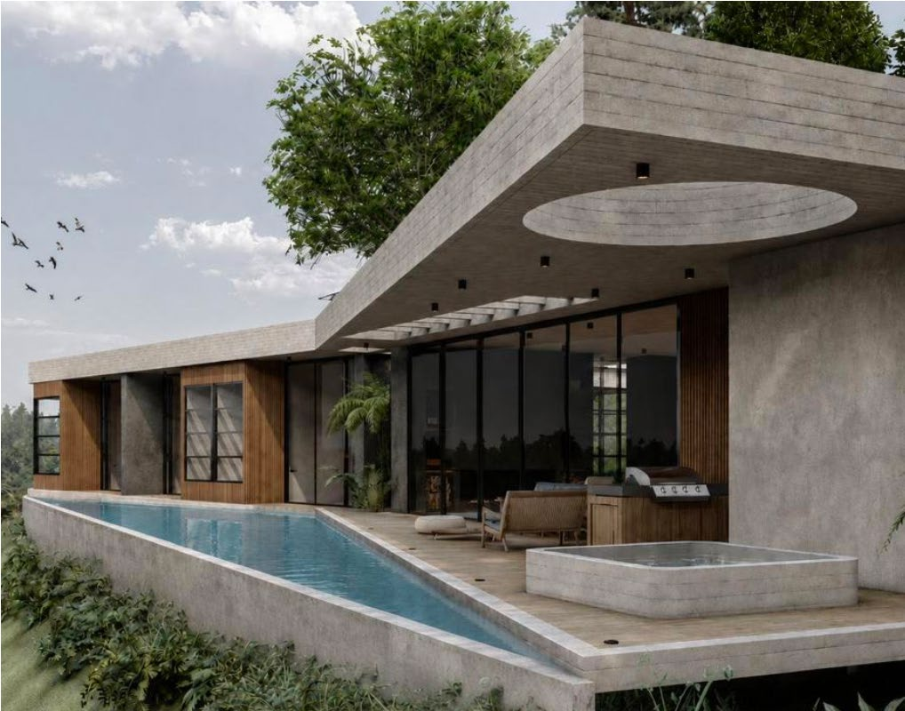
Thank You
K. Dov Isaza Tuzman
MANAGING DIRECTOR · DULCINEA
kit@kitcapital.com

Slide 13
Appendix
Property detail and financial statements

Slide 14
ACTIVE PORTFOLIO · PROPERTY 1 OF 5
San Lucas 101
El Poblado, Medellín · Apartment · 325 m² (3,498 sq ft)
CRITERIA
CLEARED
◆
NEGOTIATED — COMPRAVENTA DRAFTED
CRITERIA CHECK
IN THE FUND
Submarket
El Poblado furnished apartment, estrato 5–6
Entry price
Purchase $445K · all-in $747K
Works
Six-month renovation; $291K budget
Bridge rental
Furnished let ~20 months while marketed · ~$24K NOI/yr · not relied on
Exit
4Q26 → 1Q29 · 25-month hold · $1.27M, 1.69× uplift

Slide 15
ACTIVE PORTFOLIO · PROPERTY 2 OF 5
Aires de Campestre
El Poblado, Medellín · Penthouse · 489 m² (5,264 sq ft)
CRITERIA
CLEARED
■
SIGNED — CLOSING SEP 2026
CRITERIA CHECK
IN THE FUND
Submarket
El Poblado penthouse, estrato 5–6
Entry price
Purchase $667K · all-in $1.17M
Works
Six-month renovation; $485K budget
Bridge rental
Let ~23 months while marketed · $19K NOI/yr
Exit
4Q26 → 1Q29 · 28-month hold · $2.02M, 1.73× uplift

Slide 16
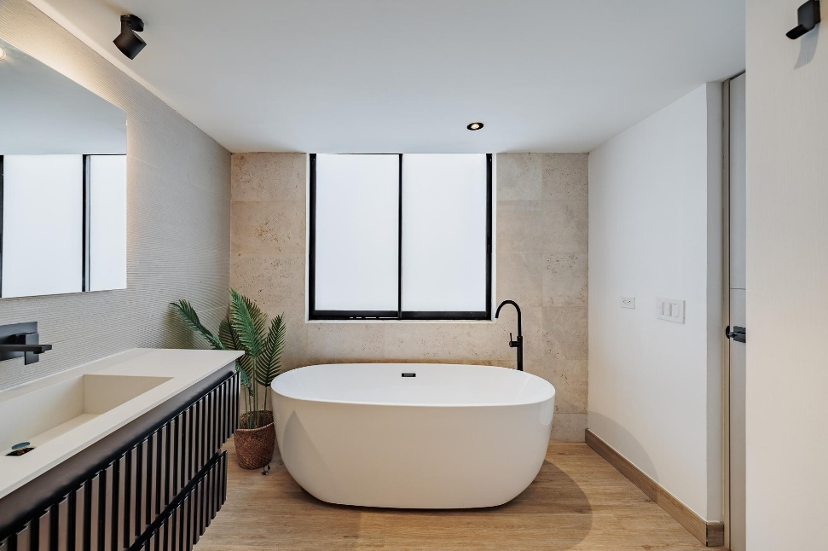
ACTIVE PORTFOLIO · PROPERTY 3 OF 5
Fontanar 201
El Poblado, Medellín · Penthouse · 389 m² (4,187 sq ft)
CRITERIA
CLEARED
■
SIGNED — CLOSING SEP 2026
CRITERIA CHECK
IN THE FUND
Submarket
El Poblado penthouse, estrato 5–6
Entry price
Purchase $1.02M · all-in $1.29M
Works
Six-month renovation; $246K budget
Bridge rental
Let ~25 months while marketed · $17K NOI/yr
Exit
4Q26 → 2Q29 · 30-month hold · $2.26M, 1.75× uplift

Slide 17
ACTIVE PORTFOLIO · PROPERTY 4 OF 5
Casa Monte Sereno
El Retiro, Antioquia · House · 420 m² on a 2,940 m² lot
CRITERIA
CLEARED
◆
NEGOTIATED — FINALIZING MODIFICATIONS
CRITERIA CHECK
IN THE FUND
Submarket
El Retiro estate, Parcelación Monte Sereno
Entry price
Purchase $1.29M · all-in $1.65M
Works
Six-month renovation; $324K budget
Bridge rental
Let ~27 months while marketed · NOI $13K/yr
Exit
1Q27 → 4Q29 · 32-month hold · $2.83M, 1.72× uplift

Slide 18
ACTIVE PORTFOLIO · PROPERTY 5 OF 5
Casa Montana
El Retiro, Antioquia · House · 591 m² (6,361 sq ft)
CRITERIA
CLEARED
◆
NEGOTIATED — WORKS BEING BUDGETED
CRITERIA CHECK
IN THE FUND
Submarket
El Retiro estate, Parcelación Montana
Entry price
Purchase $1.14M · all-in $1.71M
Works
Nine-month renovation; $550K budget
Bridge rental
Let ~30 months while marketed · $24K NOI/yr
Exit
2Q27 → 2Q30 · 35-month hold · $3.00M, 1.75× uplift

Slide 19
Financial Performance
$4.88M
contribution margin, all four years
40.6%
$3.66M
contribution margin on revenue
net income after taxes
Y1
Y2
Y3
Y4
Total
Rental income
Property sales (gross)
Total revenue
Variable costs — cost basis, selling costs, rent fees
Contribution margin
Contribution margin %
Fixed property costs — predial, HOA, insurance
General & administrative
EBITDA
Tax on gains at 15% occasional-gains rate
Net income
84,226
0
84,226
(17,898)
66,328
78.8%
(87,758)
(104,653)
(126,084)
0
(126,084)
308,212
0
308,212
(65,495)
242,717
78.8%
(143,443)
(97,305)
1,968
(689)
1,279
210,510
5,546,509
5,757,020
(3,462,499)
2,294,520
39.9%
(98,752)
(77,724)
2,118,045
(280,708)
1,837,337
40,479
5,830,402
5,870,881
(3,595,125)
2,275,756
38.8%
(16,458)
(26,277)
2,233,022
(287,900)
1,945,121
643,427
11,376,911
12,020,339
(7,141,017)
4,879,321
40.6%
(346,411)
(305,959)
4,226,951
(569,297)
3,657,653
Contribution margin = revenue less cost basis, selling costs and rent-linked fees. Rental income accrues only while a property is held; all five exit by Year 4, so Years 5 onward are nil. Rental income does not cover property operating costs, so no ordinary income tax arises. All figures in USD.
Notes:
Tasa de ocupación de casas.

Slide 20
Balance Sheet
No debt, ever. The program fully liquidates by Year 4
Properties are carried at cost until sold. Commitments are drawn only as acquisitions close, never up front.
YEAR 1
YEAR 2
YEAR 3
YEAR 4
$6.50M
$6.59M
$3.37M
$0
total assets = total equity
total assets = total equity
total assets = total equity
fully liquidated — all capital and profit distributed
Equity
Equity
✓
Equity
Balance check reads zero. Program wound down; nothing left on the books.
ASSETS
EQUITY · DEBT $0
ASSETS
EQUITY · DEBT $0
ASSETS
EQUITY · DEBT $0
$6,480,272 real estate
$6,571,966 real estate
$3,364,968 real estate
$24,326 cash
$19,431 cash
$6,569 cash
Balance check reads zero every period. All capital and profit is distributed by Year 4.

Slide 21


